Slide 1
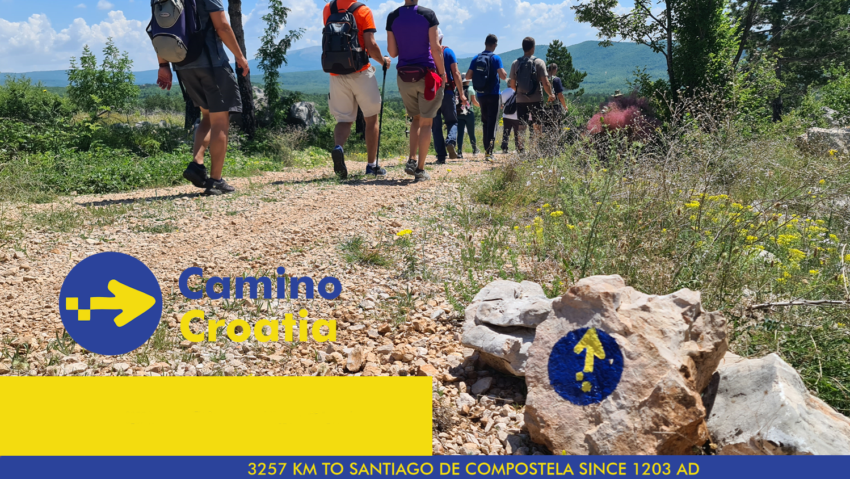
Cultural Route Camino de Santiago
examples of good practices - Croatia

Slide 2
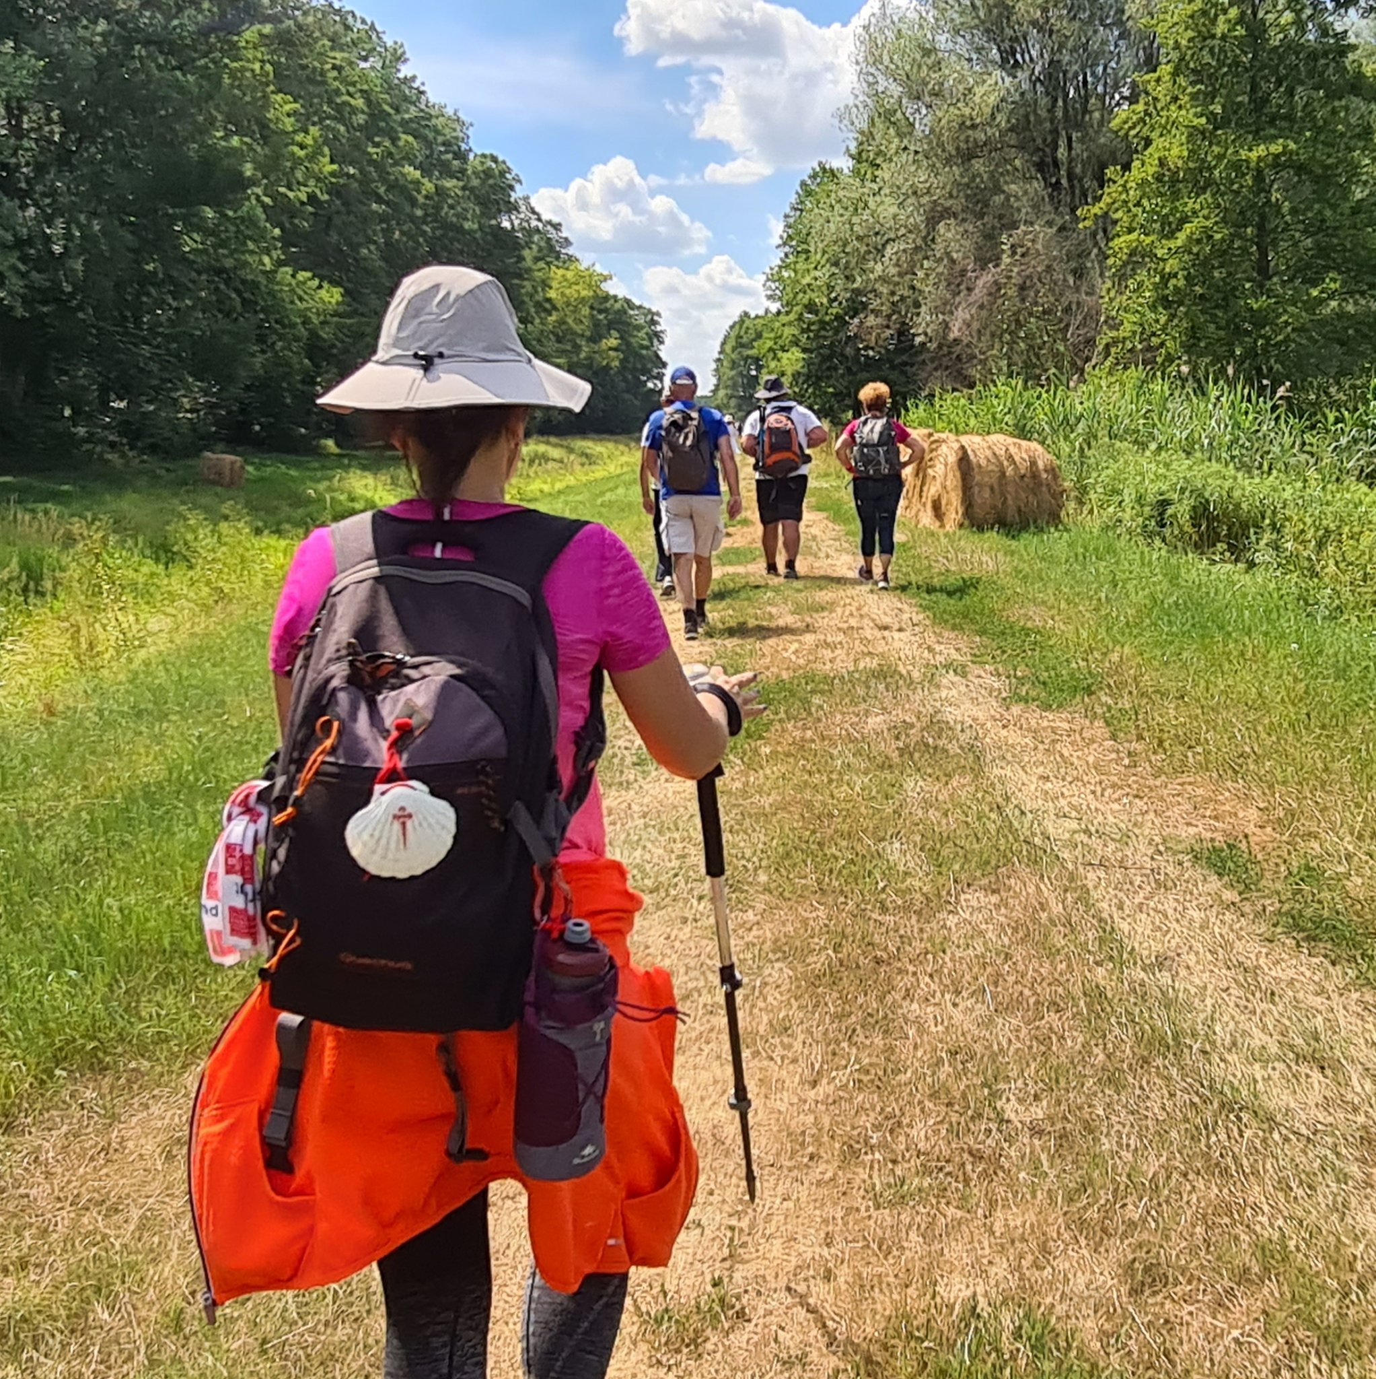
INTRODUCTION
October 2019.
Starting the development of Camino route in Croatia
20 camino enthusiasts
0 € budget
October 2024.
30.000+ pilgrims
on over 1.500 km
of signposted Camino route in Croatia
annual budget 60.000 €

Slide 3
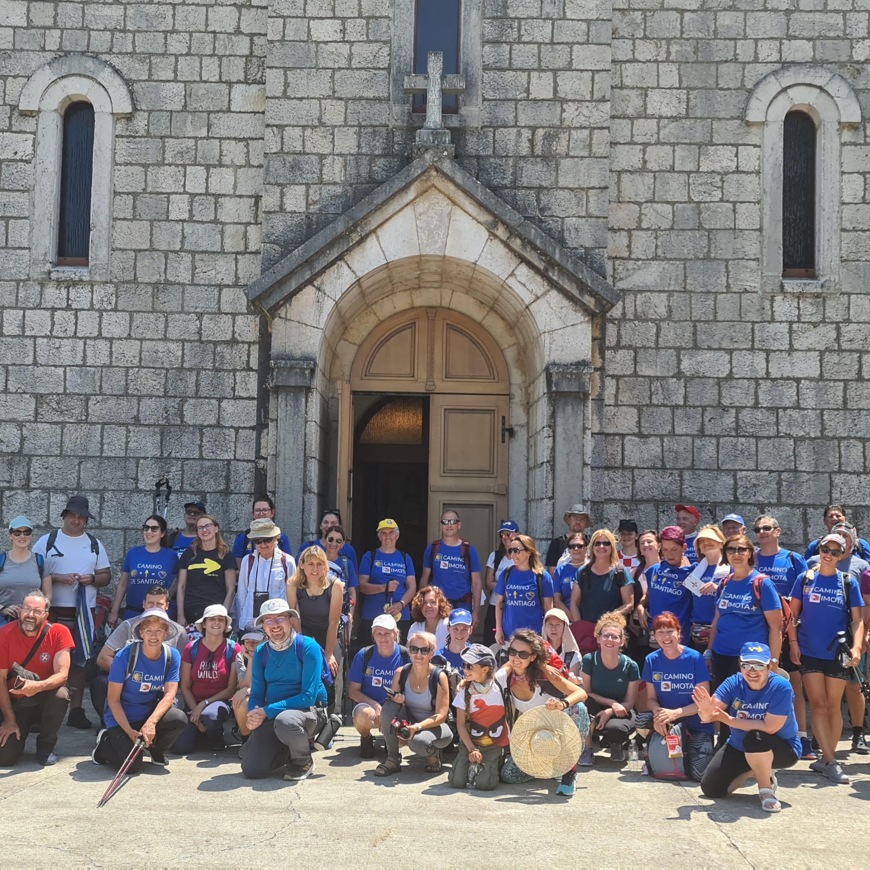
PRIORITY
1st
Focus on the main goal:
maximize number of pilgrims on Camino route in Croatia and offer them authentic “Camino experience”
2nd
Core team focused on the goal
and not on individual ego’s

Slide 4
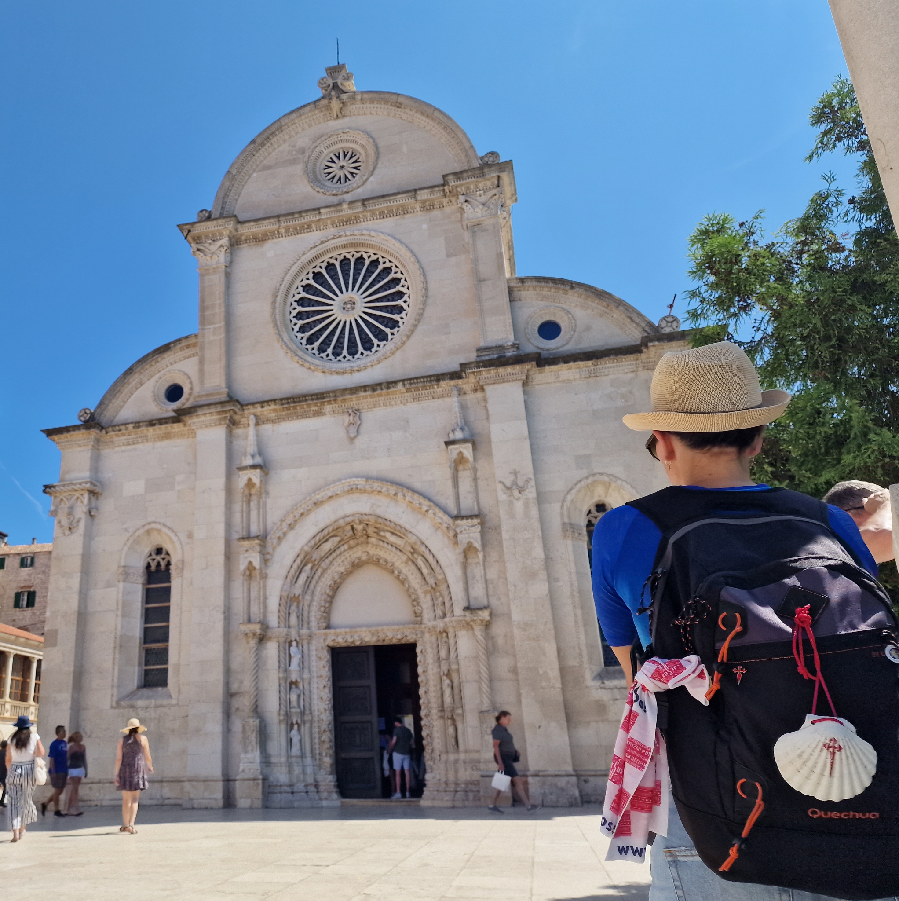
OUR CONCEPT
Camino route planning based on churches and sanctuaries dedicated to St. James
Inclusion of local cultural and natural heritage
Camino experience as open to all - regardless of their religious beliefs, ideology.
“Everyone walks their own Camino”
Project stages
1st Route development
2nd Route promotion
3rd Pilgrim support

Slide 5
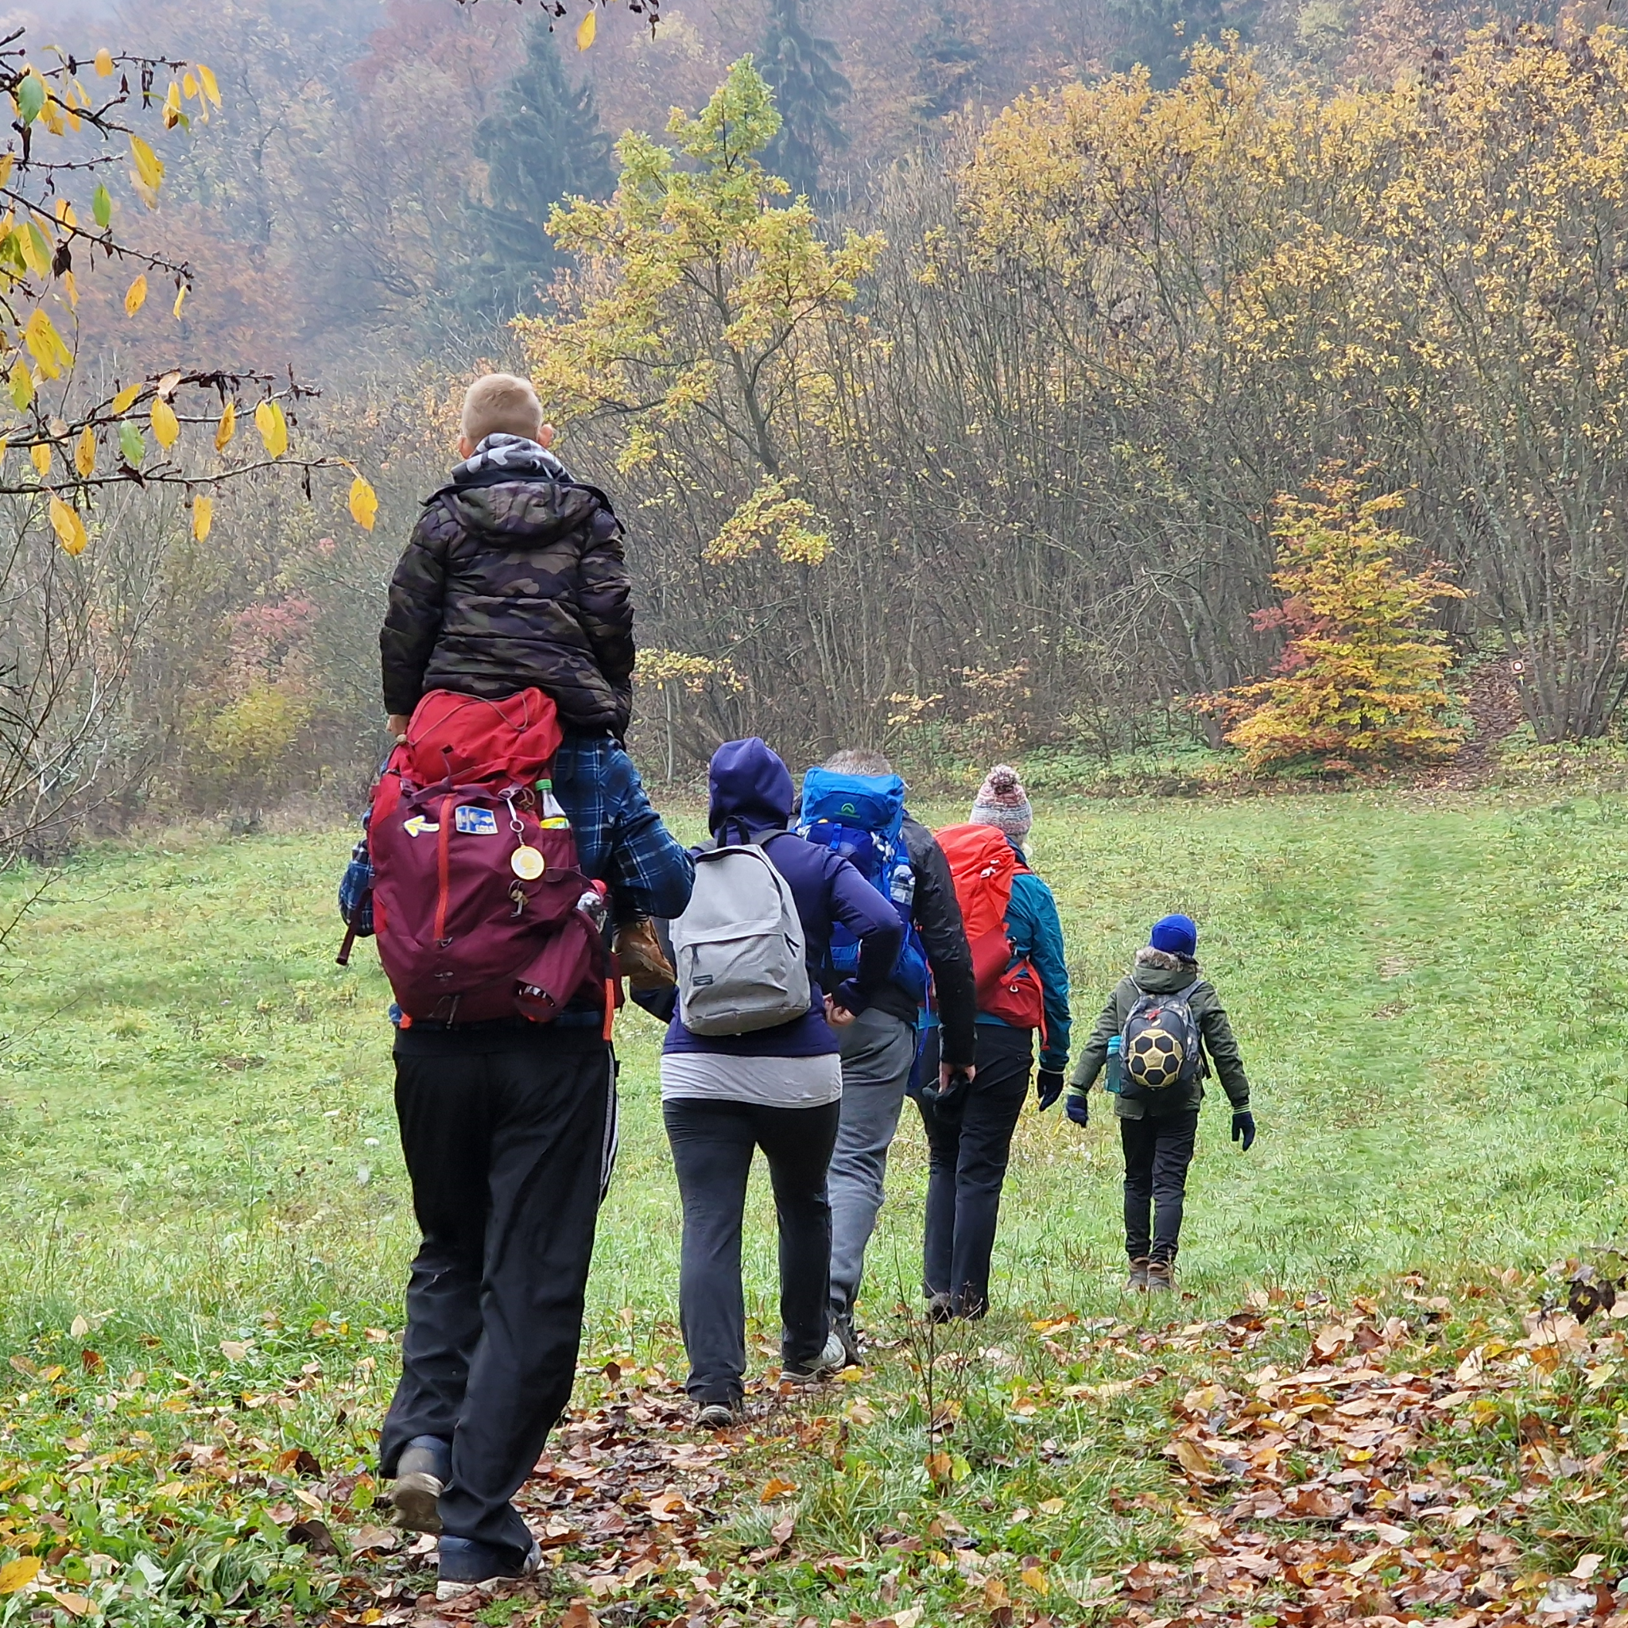
OUR STRATEGY
International cooperation
Official certification of Croatian credential
Membership in Archicofradia Universal - oldest Camino institution founded in 1492.
Cooperation with other Camino associations in Europe, Xacobeo, Xunta de Galicia
Membership in “Camino Europa Compostela” - federation of Camino associations
PR strategy promoting every result achieved
Building credibility towards potential partners

Slide 6
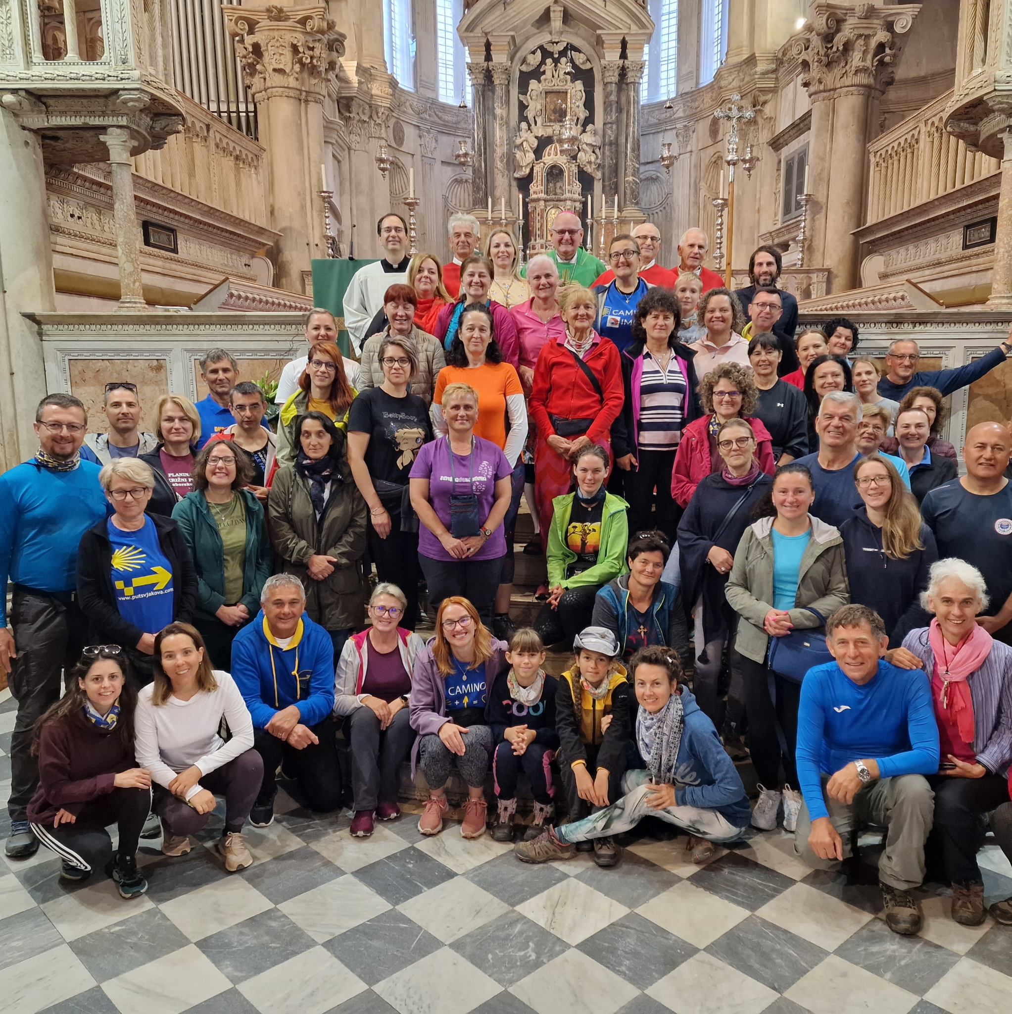
LOCAL COOPERATION
Key strategy
Cooperation with local tourist boards /municipalities
Our need:
Funding for the development of the Camino route
(signposting, infrastructure,, marketing)
Their need:
More visitors to their destinations
throughout the year (less popular destinations)
outside of summer months (seaside destinations)

Slide 7
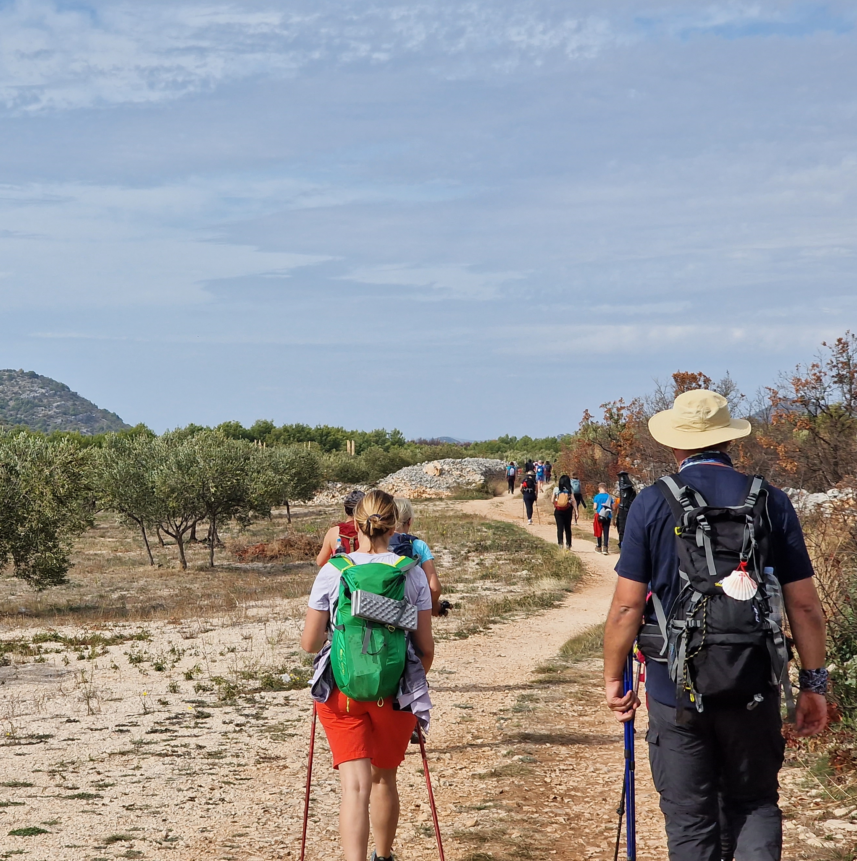
MARKETING
Key advantages
Camino de Santiago as a global brand
(over 2.5 million google searches per month)
2 or 7 day walk in Croatia vs. 30 day walk in Spain
Marketing activities
Organized events, PR
Social media, target Facebook groups
Google for Nonprofits Ad grant (10.000 $ per month)
Virtual Camino experience program
Organizing international Camino festival

Slide 8
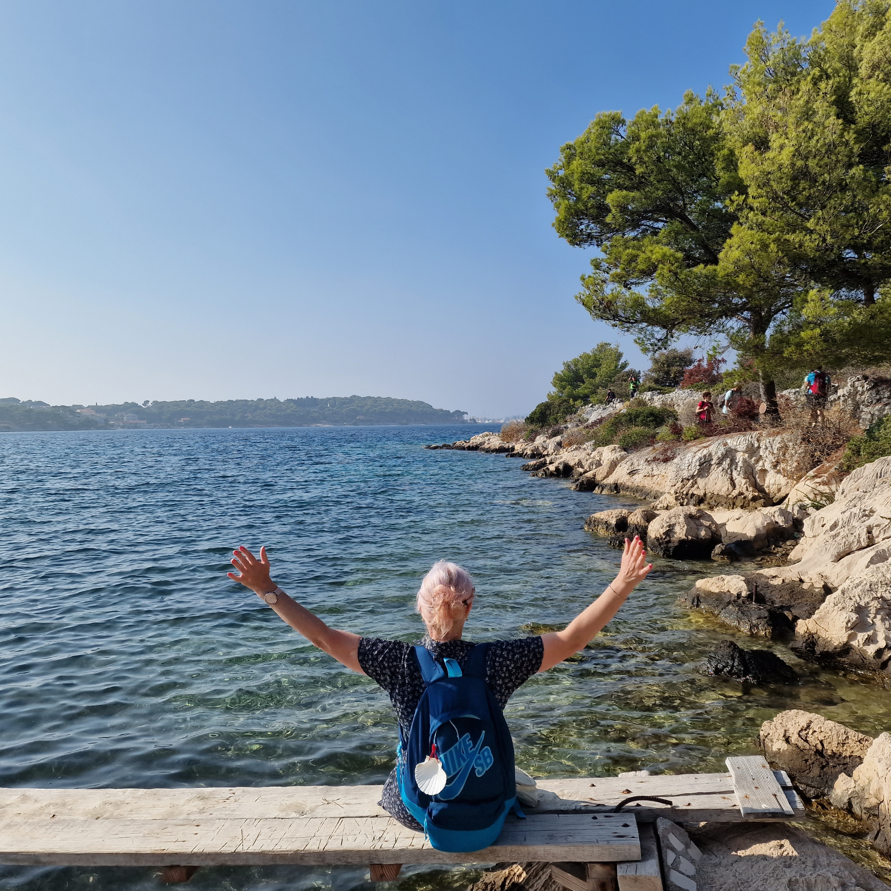
FUTURE PLANS
Increased cooperation with other members of “Camino Europa Compostela” federation
Cooperation with local tourist boards /municipalities
EU project funding
directly (Erasmus+)
in cooperation with local municipalities (INTERREG, Creative Europe)
Goal?
500.000 pilgrims walking the Camino route in Croatia (annually)

